Slide 1
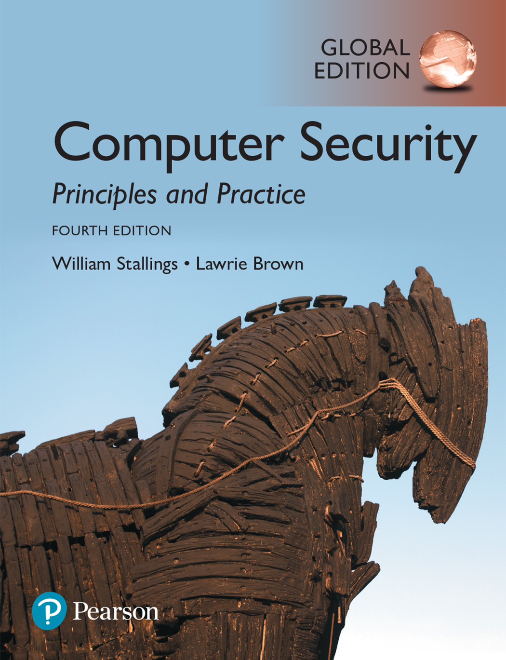

Slide 2
Chapter 3
User Authentication

Slide 3
Digital user authentication
“The process of establishing confidence in user identities that are presented electronically to an information system.”
Notes:
NIST SP 800-63-3 (Digital Authentication Guideline , October 2016) defines digital
user authentication as the process of establishing confidence in user identities
that are presented electronically to an information system. Systems can use the
authenticated identity to determine if the authenticated individual is authorized
to perform particular functions, such as database transactions or access to system
resources. In many cases, the authentication and transaction, or other authorized
function, take place across an open network such as the Internet. Equally authentication
and subsequent authorization can take place locally, such as across a local
area network.

Slide 4
Authentication process
In most computer security contexts, user authentication is the fundamental building block and the primary line of defense. User authentication is the basis for most types of access control and for user accountability. User authentication encompasses two functions.
First, the user identifies herself to the system by presenting a credential, such as user ID.
Second, the system verifies the user by the exchange of authentication information.
identification is the means by which a user provides a claimed identity to the system; user authentication is the means of establishing the validity of the claim.

Slide 6
Means of Authentication
There are four general means of authenticating a user’s identity, which can be used alone or in combination:
Something the individual knows: Examples includes a password, a personal identification number (PIN), or answers to a prearranged set of questions.
Something the individual possesses: Examples include electronic keycards, smart cards, and physical keys. This type of authenticator is referred to as a token.
Something the individual is (static biometrics): Examples include recognition by fingerprint, retina, and face.
Something the individual does (dynamic biometrics): Examples include recognition by voice pattern, handwriting characteristics, and typing rhythm.

Slide 7
Password-Based Authentication
Widely used line of defense against intruders
User provides name/login and password
System compares password with the one stored for that specified login
The user ID:
Determines that the user is authorized to access the system
Determines the user’s privileges
Is used in discretionary access control

Slide 8
The Vulnerability of Passwords
We can identify the following attack strategies and countermeasures for password based authentication:
Offline dictionary attack: The attacker obtains the system password file and compares the password hashes against hashes of commonly used passwords. If a match is found, the attacker can gain access by that ID/password combination. Countermeasures include controls to prevent unauthorized access to the password file, intrusion detection measures to identify a compromise, and rapid reissuance of passwords should the password file be compromised.
Specific account attack: The attacker targets a specific account and submits password guesses until the correct password is discovered. The standard countermeasure is an account lockout mechanism, which locks out access to the account after a number of failed login attempts.

Slide 9
The Vulnerability of Passwords
Popular password attack: A variation of the preceding attack is to use a popular password and try it against a wide range of user IDs. Countermeasures include policies to inhibit the Selection by users of common passwords and scanning the IP addresses of authentication requests and client cookies for submission patterns.
Password guessing against single user: The attacker attempts to gain knowledge about the account holder and system password policies and uses that knowledge to guess the password. Countermeasures include training in and enforcement of password policies that make passwords difficult to guess.
Workstation hijacking: The attacker waits until a logged-in workstation is unattended. The standard countermeasure is automatically logging the workstation out after a period of inactivity.

Slide 10
The Vulnerability of Passwords
Exploiting user mistakes: If the system assigns a password, then the user is more likely to write it down because it is difficult to remember. This situation creates the potential for an adversary to read the written password. A user may intentionally share a password, to enable a colleague to share files, for example. Countermeasures include user training, intrusion detection, and simpler passwords combined with another authentication mechanism.
Exploiting multiple password use: Attacks can also become much more effective or damaging if different network devices share the same or a similar password for a given user. Countermeasures include a policy that forbids the same or similar password on particular network devices.
Electronic monitoring: If a password is communicated across a network to log on to a remote system, it is vulnerable to eavesdropping. Simple encryption will not fix this problem, because the encrypted password is, in effect, the password and can be observed and reused by an adversary.

Slide 11
Password Selection Strategies
Users can be told the importance of using hard-to-guess passwords and can be provided with guidelines for selecting strong passwords. This user education strategy is unlikely to succeed at most installations.
Computer-generated passwords also have problems. If the passwords are quite random in nature, users will not be able to remember them.

Slide 12
Password Selection Strategies
A reactive password checking strategy is one in which the system periodically runs its own password cracker to find guessable passwords. The system cancels any passwords that are guessed and notifies the user.
A promising approach to improved password security is a complex password policy, or proactive password checker. In this scheme, a user is allowed to select his or her own password. However, at the time of selection, the system checks to see if the password is allowable and, if not, rejects it.

Slide 13
Token-Based Authentication
Objects that a user possesses for the purpose of user authentication are called tokens.

Slide 14
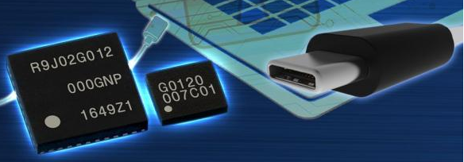
Memory Cards
Memory cards can store but not process data. The most common such card is the bank card with a magnetic stripe on the back.
A magnetic stripe can store only a simple security code, which can be read (and unfortunately reprogrammed) by an inexpensive card reader. There are also memory cards that include an internal electronic memory.
The memory card, when combined with a PIN or password, provides significantly greater security than a password alone. An adversary must gain physical possession of the card (or be able to duplicate it) plus must gain knowledge of the PIN.

Slide 15
Potential drawbacks of Memory Cards
Among the potential drawbacks are the following:
Requires special reader: This increases the cost of using the token and creates the requirement to maintain the security of the reader’s hardware and software.
Token loss: A lost token temporarily prevents its owner from gaining system access.
User dissatisfaction: Although users may have no difficulty in accepting the use of a memory card for ATM access, its use for computer access may be deemed inconvenient.

Slide 16
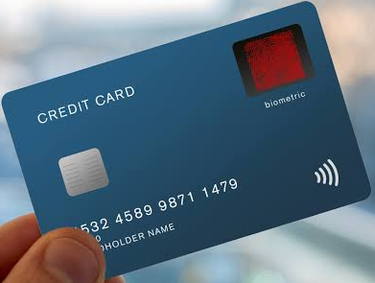
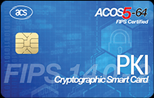
Smart Cards
A wide variety of devices qualify as smart tokens. These can be categorized along four dimensions that are not mutually exclusive:
Physical characteristics: Smart tokens include an embedded microprocessor. A smart token that looks like a bank card is called a smart card. Other smart tokens can look like calculators, keys, or other small portable objects.
User interface: Manual interfaces include a keypad and display for human/ token interaction.
Electronic interface: A smart card or other token requires an electronic interface to communicate with a compatible reader/writer. A card may have one or both of the following types of interface:
Contact
Contactless

Slide 17
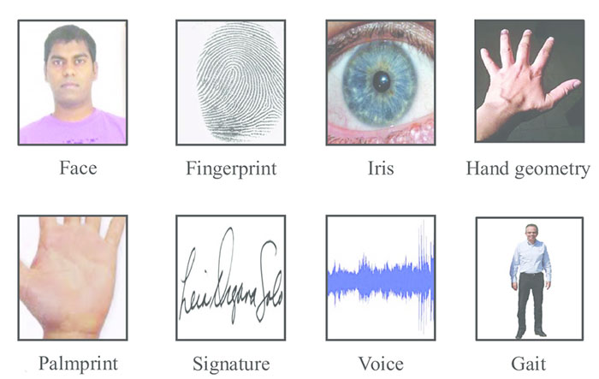
Biometric Authentication
A biometric authentication system attempts to authenticate an individual based on his or her unique physical characteristics. These include static characteristics, such as fingerprints, hand geometry, facial characteristics, and retinal and iris patterns; and dynamic characteristics, such as voiceprint and signature. In essence, biometrics is based on pattern recognition.

Slide 18
Physical Characteristics Used in Biometric Applications
A number of different types of physical characteristics are either in use or under study for user authentication. The most common are the following:
Facial characteristics: Facial characteristics are the most common means of human-to-human identification; thus it is natural to consider them for Identification by computer.
Fingerprint : A fingerprint is the pattern of ridges and furrows on the surface of the fingertip. Fingerprints are believed to be unique across the entire human population. In practice, automated fingerprint recognition and matching system extract a number of features from the fingerprint for storage as a numerical surrogate for the full fingerprint pattern.
Retinal pattern: The pattern formed by veins beneath the retinal surface is unique and therefore suitable for identification. A retinal biometric system obtains a digital image of the retinal pattern by projecting a low-intensity beam of visual or infrared light into the eye.

Slide 19
Physical Characteristics Used in Biometric Applications
Hand geometry: Hand geometry systems identify features of the hand, Including shape, and lengths and widths of fingers.
Iris: Another unique physical characteristic is the detailed structure of the iris.
Signature: Each individual has a unique style of handwriting and this is reflected especially in the signature, which is typically a frequently written sequence.
Voice: Whereas the signature style of an individual reflects not only the unique physical attributes of the writer but also the writing habit that has developed, voice patterns are more closely tied to the physical and anatomical characteristics of the speaker. Nevertheless, there is still a variation from sample to sample over time from the same speaker, complicating the biometric recognition task.

Slide 20
Relative cost and accuracy of biometric measures

Slide 21
Operation of a Biometric Authentication System
Each individual who is to be included in the database of authorized users must first be enrolled in the system. Depending on application, user authentication on a biometric system involves either verification or identification. Verification is analogous to a user logging on to a system by using a memory card or smart card coupled with a password or PIN. For biometric verification, the user enters a PIN and also uses a biometric sensor.
The system extracts the corresponding feature and compares that to the template stored for this user. If there is a match, then the system authenticates this user.
For an identification system, the individual uses the biometric sensor but presents no additional information. The system then compares the presented template with the set of stored templates. If there is a match, then this user is identified. Otherwise, the user is rejected.
Figure below illustrates the operation of a biometric system.

Slide 22
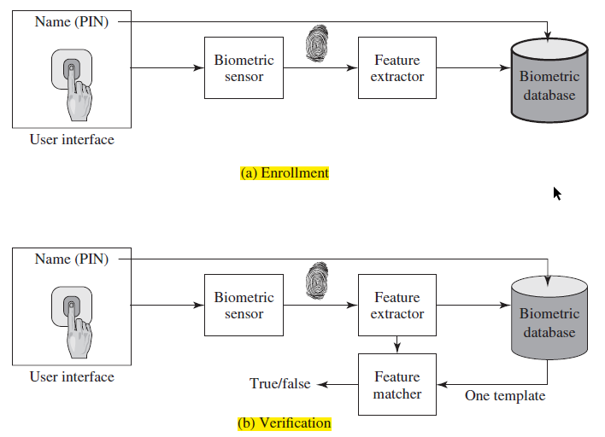

Slide 23
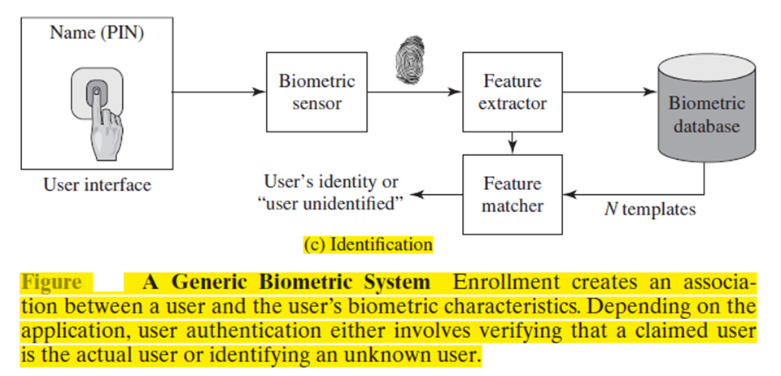

Slide 24
Security Issues for User Authentication
As with any security service, user authentication, particularly remote user authentication, is subject to a variety of attacks. Following are the main security attacks / issues for user authentication:
Client attacks are those in which an adversary attempts to achieve user authentication without access to the remote host or to the intervening communications path. The adversary attempts to masquerade as a legitimate user.
Host attacks are directed at the user file at the host where passwords, token passcodes, or biometric templates are stored.

Slide 25
Security Issues for User Authentication
Eavesdropping in the context of passwords refers to an adversary’s attempt to learn the password by observing the user, finding a written copy of the password, or some similar attack that involves the physical proximity of user and adversary.
In a Trojan horse attack, an application or physical device masquerades as an authentic application or device for the purpose of capturing a user password, passcode, or biometric. The adversary can then use the captured information to masquerade as a legitimate user. A

Slide 26
Security Issues for User Authentication
Replay attacks involve an adversary repeating a previously captured user response. The most common countermeasure to such attacks is the challenge-response protocol.
A denial-of-service (DoS) attack attempts to disable a user authentication service by flooding the service with numerous authentication attempts. A more selective attack denies service to a specific user by attempting logon until the threshold is reached that causes lockout to this user because of too many logon attempts.

Slide 27
Thank You!

